Slide 1
Профілювання ситуації з внутрішньо переміщиними особами у Краматорську та Сєвєродонецьку з особливою увагою до житла Сєвєродонецьк, 21 вересня 2021р.

Slide 2
Мета житлового проєкту МОМ
Забезпечення доступним житлом внутрішньо переміщених осіб (ВПО) у постраждалих від конфлікту районах на сході України, а також надання житла частині місцевого населення, яке не зазнало переміщення, але потребує доступного житла.
Розбудова потенціалу партнерів для досягнення сталих результатів.

Slide 3
Цілі профілювання ВПО
Отримати загальне уявлення про поточний профіль ВПО у Краматорську та Сєвєродонецьку.
Провести соціально-економічні дослідження як у Краматорську, так і в Сєвєродонецьку для поглиблення розуміння МОМ проблем ВПО та житлових потреб на сході України.

Slide 4
Огляд звіту
Короткий огляд змісту
Вступ, обґрунтування та цілі
Методологія та обмеження дослідження
Основні висновки
Демографічна структура
Засоби до існування та економіка домогосподарств
Бажане планування квартири
Житлові програми
Висновки та рекомендації

Slide 5
Методологія
Основи профілювання
Консультативна група та ключові інформанти
Опитування домогосподарств
Обговорення у фокус-групах
Обмеження дослідження
Notes:
Profiling
This will assist the Housing Project team in how it designs the layout of apartments for the population, as well as in developing criteria for the selection of potential residents of the newly-constructed housing units.
The data collection tools developed for this project differ from those used in conventional IDP profiling in that they largely focus on collecting data related to housing needs and preferences that will inform the Housing Project team as they develop the construction and design plans for the housing units.
Literature review – establish which data was needed
Advisory Group
At an early stage in the study, two Advisory Groups were established: one for each of the IDP profiling exercises in Kramatorsk and Sievierodonetsk. Both Advisory Group comprised representatives of key partners: the respective city’s municipal authority and IDP Council, a displaced university, as well as the Ministry for Reintegration of Temporarily Occupied Territories of Ukraine.
The purpose of the Advisory Groups was to critically examine the IDP profiling exercise at various stages in order to ensure that the process had been developed and implemented based upon extensive consultation with key stakeholders; and ultimately, their endorsement was secured.
Key informants: Also met and consulted with other partners and stakeholders to establish which data was already available and what they felt was required.
FGDs
- The purpose of conducting the FGDs was to provide an opportunity to explore questions and anomalies that emerged from the survey data collected, as well as allow for a more in-depth exploration of important themes that can only be achieved through qualitative research.
This involved holding discussions with groups of older (over 55 years) IDPs and non-IDPs, IDP women specifically, and IDPs and non-IDPs of mixed age groups comprising both men and women.
Limitations
Under normal circumstances, the household survey for this study would have been conducted by enumerators visiting the homes of respondents and conducting face-to-face interviews using a questionnaire.
However, health and safety concerns surrounding the COVID-19 pandemic meant that the interviews were conducted exclusively by telephone instead.
Potential respondents tend to be more reluctant to participate in a survey over the phone (especially when “cold calling” them, as is the case for this study),
It also means that it is not possible to collect supplementary information based upon observation of their housing and living situation.
Household survey
The main component of this profiling exercise — and the source of the bulk of the data collected — is a household survey using a questionnaire.
In order to comply with health and safety guidelines and restrictions related to the COVID-19 pandemic, all survey interviews were conducted by telephone.

Slide 6
Вибірка з опитування домогосподарств
Період часу: Лютий– Квітень 2021
n = 1 831 респондент (1 242 ВПО та 589 не ВПО)
Достовірність: 90% у Сєвєродонецьку
Похибка: 5%
Notes:
17 enumerators collected data for HH Survey from mid-February until early April 2021.
In total, completed questionnaires were collected from 1,831 respondents who were interviewed for the survey between mid-February and early April 2021. Of these, 1,242 are IDPs and 589 are local residents who have not been displaced (non-IDPs).

Slide 7
ОСНОВНІ ВИСНОВКИ

Slide 8
Демографічна структура
Середній розмір домогосподарства:
3 людини
У 84% домогосподарств:
2, 3 або 4 людини
Домогосподарство очолює тільки мати/батько/один опікун:
23% ВПО
10% не ВПО
Частка населення з інвалідністю:
7%

Slide 9
Засоби для існування та економіка домогосподарств
2 члени ДГ мають постійний заробіток: 54% ВПО
59% не ВПО
1 член ДГ має постійний заробіток: 41% ВПО
23% не ВПО
Середній місячний дохід ДГ: 8,000-10,000 грн.
Основне джерело доходу: У сфері державного управління та пенсії (ВПО)
У сфері державного управління та освіти (не ВПО)
Notes:
The proportion of households in which two members earn a regular income is 45 per cent for IDPs and 59 per cent for non-IDPs. A relatively high proportion, over 41 per cent, of IDP households in Sievierodonetsk reported only one regular wage earner, compared with 23 per cent of non-IDPs
The household income for both IDP and non-IDP respondents most commonly fell between 8,000 and 10,000 UAH per month in both 2019 and 2020.
Pension payments are the second most common primary source of income among IDPs after employment in public administration. Public administration is the largest employer among non-IDPs, followed by the education sector.
Name thrird and fourth

Slide 10
Основне джерело доходу для домогосподарств ВПО та домогосподарств осіб, які не є ВПО, у Сєвєродонецьку

Slide 11
Засоби для існування та економіка домогосподарств (2)
Проживають в орендованому житлі: 66% ВПО
14% не ВПО
Проживають у власному житлі: 14% ВПО
80% не ВПО
Середньомісячна орендна
плата: 3,000-5,000 грн. (36% ВПО)
Місячний дохід: >4000 грн. (55% не ВПО)
Місячні комунальні платежі: >1000 грн. (49% )
Notes:
Over 66 per cent of IDPs and 14 per cent of non-IDPs live in rented apartments.
Some 14 per cent of IDPs own their own homes compared with 80 per cent of non-IDPs.
The most prevalent monthly rental price for IDPs in Sievierodonetsk is UAH 3,001 to 5,000, which is paid by 36 per cent of households.
Overall, IDPs pay relatively high levels of rent in Sievierodonetsk, and often more than non-IDPs do on average, albeit proportionately far fewer non-IDPs live in properties that they rent.
About 55 per cent of IDPs earn UAH 4,000 or less and 49 per cent of these pay UAH 1,000 or less for their utility bills.
WHICH MEANS ABOUT 50% OF IDPS WHO EARN UAH 4000 OR LESS PAY MORE THAN UAH 1000 FOR THEIR UTILITY COSTS.
IDPs suggested that they would be willing to pay up to UAH 3,000 per month for a new, unfurnished one-bedroom apartment.

Slide 12
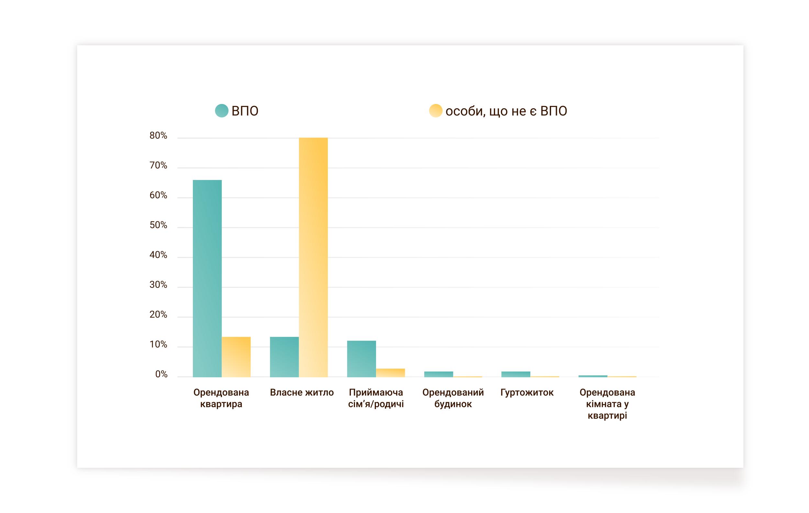
Тип житла домогосподарств ВПО та домогосподарств осіб, які не є ВПО, у Сєвєродонецьку

Slide 13
Середньомісячна орендна плата, яку сплачують особи, які є та не є ВПО, у Сєвєродонецьку

Slide 14
Тип житла домогосподарств ВПО та домогосподарств осіб, які не є ВПО, у Сєвєродонецьку

Slide 15
Гарантії проживання
Кількість переїздів після переміщення:
3 рази або більше - 57%
Два рази - 24%
Основні причини:
Погані умови життя*
Висока вартість орендних платежів
Виселення
Notes:
Security of tenure was a major concern, as the eviction of tenants at short notice is reportedly a widespread problem.
- Some 57 per cent of IDPs have moved residence three times or more and 24 per cent had moved twice.
- So over 80% of IDPs in Severodonetsk have relocated at least twice since initial displacement.
IDPs moved out of their previous residence(s) due to: poor living conditions; high cost of rental payments; and being evicted by the owner/landlord for one reason or another.
The principal reason provided by IDPs for wanting to move or planning to was due to poor living conditions. The main reason for non-IDPs was in order to purchase a property.

Slide 16
Основні причини зміни попереднього місця проживання ВПО у Сєвєродонецьку

Slide 17
Житлові програми та вподобання
Високий рівень знань та зацікавленості
Багато хто думає, що вони не задовольняють умовам програм
Відсутність вподобань до моделі житлової програми
Зацікавленість в отриманні кредиту
Тип моделі оренди/купівлі житла: широкий спектр уподобань
Ціна оренди досить низька, але квартира має бути в належному стані та з основним обладнанням
За управляння має відповідати урядова/муніципальна адміністрація
Notes:
High level of knowledge and interest in housing programmes among IDPs
Many IDPsthink they would be ineligible because of their age, location, IDP status and/or financial circumstances
Most of those that expressed an interest in housing programmes did not significantly prefer one model over another among those that were suggested
While there is a good deal of mistrust towards banks and state institutions, many IDPs would be interested in applying for a loan if the interest rates were reasonably low and fixed for about 10 years.
When provided with various options in relation to their preferences in renting an apartment long-term that has been renovated, furnished and/or equipped with appliances, the vast majority of IDPs and non-IDPs in both cities favour a compromise option:
- the rental price should be low; but it should also be in reasonably in good order and equipped with a plumbed bathroom suite, as well as a sink and stove in the kitchen.
With respect to the management arrangements for their residential buildings, the most preferred option (among those that did express a preference) for both IDP and non-IDP respondent groups is for a government/municipality administration to be responsible.
In both Kramatorsk and Sievierodonetsk, when a preference was provided, the most favoured method to search for housing opportunities is through websites and online advertising for both IDPs and non-IDPs.

Slide 18
Бажане планування квартири та місцевої інфраструктури
Кухня велика та менша вітальня
Ванна, а не душ
Балкон засклений, а не відкритий
Аптека поруч
Дитячий та спортивний майданчики
Notes:
IDPs prefer a large kitchen with a smaller living room in only slightly higher numbers than those who favour a combined space.
However, while still a minority, a relatively large proportion of non-IDPs in Sievierodonetsk favour a small kitchen with a large living room.
Most IDP and non-IDP respondents prefer to have a bath rather than a shower cabin.
In Sievierodonetsk, no additional outdoor space was the most selected option whereas a garage or workshop is the next preferred option among both groups.

Slide 19
РЕКОМЕНДАЦІЇ

Slide 20
Квартирні вподобання
З однією спальнею: 2,500-3,500 грн. (за винятком комунальних платежів у розмірі 1000 грн.)
З двома спальнями: 4,000-5,000 грн. (за винятком комунальних платежів у розмірі 1000 грн.)
Більшість вважає за краще дві спальні
Велика кухня
Засклений балкон
Гараж, майстерня
Поруч аптека, продуктовий магазин і дитячий майданчик
Notes:
For an apartment with one bedroom, an affordable rent would likely fall between UAH 2,500–3,500 per month, excluding utility bills (which should amount to less than UAH 1,000 per month). For an apartment with two bedrooms, UAH 4,000–5,000 per month would be an appropriate rental price. The prices may differ between the two cities, but not significantly.
The majority of the apartments should prioritize a large kitchen over the size of the living room. Kitchens should provide sufficient space for the household to sit and share meals together. The living room is likely to be used less as a communal space than the kitchen, and may well be a sleeping space at night.
The bathroom should have a bath rather than a shower cabin.
Not all apartments will have balconies, but those that do should have enclosed ones.
For a supplementary charge, tenants could be offered a garage or workshop space outside of the apartment.
3. Number of rooms required
Most apartments should have one or two bedrooms. It should also be possible to use the living room as a sleeping space, if desired.
A small number of apartments with three bedrooms would be desirable, but perhaps not essential.
4. Community and technical infrastructure
A pharmacy and a grocery shop (convenience store) should be located within ten minutes’ walk of the apartment blocks.
An open green space with a playground should also be located very close to the apartment blocks.
Ideally, there should be sports facilities, such as sports fields and/or a sports centre, within walking distance of the apartment blocks.
Accessibility to the buildings should be assured through on-site assessment and testing, mindful of the needs of older persons, young children and people with various types of disability.
5. Input towards the development of selection criteria for tenants
Households with children should represent a sizeable proportion of those selected.
Certain disadvantaged groups should be well represented among those selected, and perhaps prioritized for inclusion when other factors are more or less even:
People with disabilities
Households with children and only one adult parent/carer
Elderly people
Given that the project is providing affordable housing, it is important that households are able to demonstrate that they will be able afford to pay rent in the long-term, and thus do not make financial commitments which they can ill afford.
There should be no minimum requirements upon the number of household members earning a regular income, provided they are able to demonstrate a sustainable source of income.
Those selected will represent a cross section of employment sectors, to avoid any appearance of preferential treatment.

Slide 21
Thank you! Дякую!
sloughna@iom.int

